Slide 1
Data Analysis Expressions
By: Munish Arora
Munish.arora@gmail.com

Slide 2
DAX
In this, we will cover
What is DAX
Evolution
OLTP vs OLAP
Compression Techniques in OLAP
Improving Performance
Demo: Improving Performance
Calculated Columns and Measures
Demo: DAX Calculations
Demo: Common Requirements (via DAX)

Slide 3
DAX (Data Analysis Expressions)
Data Analysis Expressions (DAX) is the native formula and query language for
Microsoft Power Pivot
Power BI Desktop and
SQL Server Analysis Services (SSAS) Tabular models
Azure Analysis Services
DAX includes
Some of the functions that are used in Excel formulas and
Additional functions that are designed to work with relational data and perform dynamic aggregation.
You can use DAX to define custom calculations for Calculated Fields and Measures in Power BI

Slide 4
Evolution
DAX was developed by the SQL Server Analysis Services team at Microsoft as part of Project Gemini and released in 2009 with the first version of the PowerPivot for Excel 2010 Add-in
Over time, DAX gained popularity in the Excel community, which uses DAX to create Power Pivot data models in Excel, and in the Business Intelligence (BI) community, which uses DAX to build models with SSAS.

Slide 5
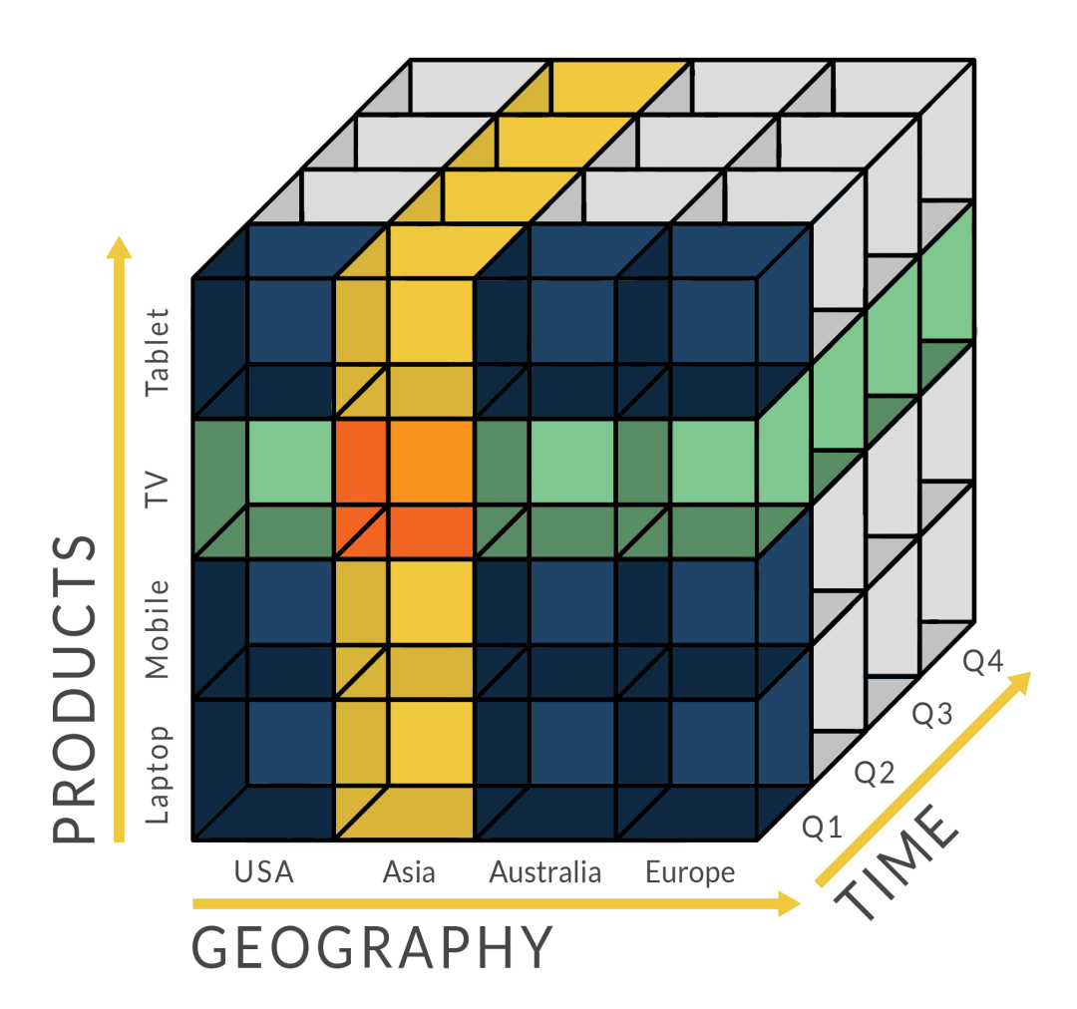
DAX: OLAP
Online Transaction Processing (OLTP)
Online Application Processing (OLAP)
Designed for large no. of transactions
Designed for daily reporting or heavy reads
OLAP is designed for reading and analysing large datasets (may be terabytes of data).
With OLAP data is typically stored as columns

Slide 6
Optimizing for OLAP
OLAP will have
Users will apply
Single Column Aggregations
Large No. of rows
Repeated Values
Filters
Total Sales for yr 2010 for country =…. And state = ….
Save denormalized data in tables
Quickly Apply Filters

Slide 7
OLTP
Lets say we have the data as follows ( just a sample), but we have lakhs of records
Order ID | Order Date | Customer ID | Sales | Payment Status | Ship Date
1001 | 1-Jan-18 | 4 | 340 | Complete | 2-Jan-18
1002 | 2-Jan-18 | 4 | 307 | Pending | 3-Jan-18
1003 | 3-Jan-18 | 2 | 101 | Complete | 4-Jan-18
1004 | 4-Jan-18 | 3 | 335 | Pending | 5-Jan-18
1005 | 5-Jan-18 | 4 | 206 | Complete | 6-Jan-18
1006 | 6-Jan-18 | 3 | 145 | Complete | 7-Jan-18
1007 | 7-Jan-18 | 2 | 166 | Pending | 8-Jan-18
Here, say the index is on Order ID, and we make a search on Payment Status =‘Complete’
It we will loop thro the rows since there is no index on Payment Status, check the indexes for those that meet the search criteria, and will fetch the Sales.
Which is a costly operation

Slide 8




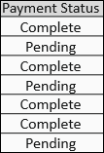

OLAP /DAX Query
In Power BI, data is being stored in Vertipaq.
The engine, used to store the data as columns, alternatively known as xVelocity
VertiPaq stores each column in a separate data structure. This simple fact allows the engine to implement some extremely important compressions
Notes:
Vertipaq – vertically packing data into columns

Slide 9
OLAP /DAX Query
Say we want Total of SalesAmount where Payment Status = Complete
It will only scan this column, and get the row numbers from Payment Status column and will scan and fetch values from Sales column for fetched row numbers.
Further, Microsoft is also using this engine in Windows OS
Notes:
Vertipaq – vertically packing data into columns

Slide 10
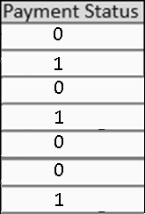
DAX Query
So, via compression, it will apply the compression algorithm, and internally it will
Have a new table for unique values of Payment Status. Thereby improving performance and reducing cost of storage
And in the transaction table it will have the corresponding integer values (id)
And when requested, it will check for records with unique value of id column
Payment Status | Id
Complete | 0
Pending | 1
Notes:
Vertipaq – vertically packing data into columns

Slide 11
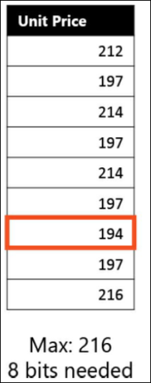
Compression Technique
Value Encoding
Value encoding stores data by applying both an offset and a reduction of the bits required to store the value, based on the range of values that are available in the column.
Suppose you have a column that contains the price of products, stored as integer values. There are many different values, and to represent them all, you need a defined number of bits.
Value encoding happens only for numeric columns.
Notes:
Vertipaq – vertically packing data into columns

Slide 12
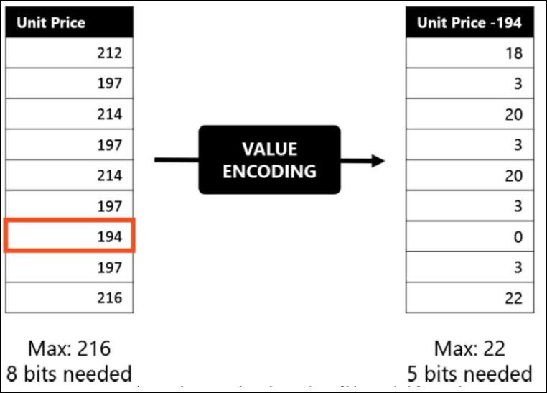
Compression Technique
Value Encoding
Let’s use the values in following figure as an example. The maximum value in the Unit Price column is 216. Therefore, you need at least 8 bits to store each value. However, by using a simple mathematical operation, you can reduce the storage to 5 bits. In this case, by subtracting the minimum value (194) from all the values in the Unit Price column, VertiPaq reduces the range of the column to a range from 0 to 22.
Storing numbers up to 22 requires fewer bits than storing numbers up to 216. While 3 bits might seem like a very small saving, when you multiply this over a few billion rows, it is easy to see that the difference can be important.
Notes:
Vertipaq – vertically packing data into columns

Slide 13
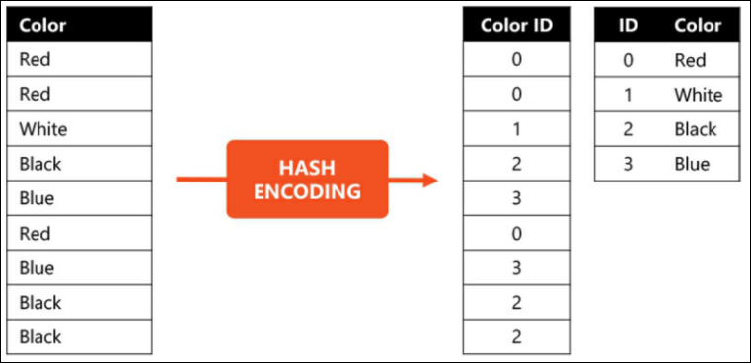
Compression Technique
HASH ENCODING
Hash encoding (also known as dictionary encoding) is another technique used by VertiPaq to reduce the number of bits required to store a column.
Hash encoding builds a dictionary of the distinct values of a column and then it replaces the column values with indexes to the dictionary. Let’s see this with an example.
When VertiPaq encodes a column with hash encoding, it does the following:
It builds a dictionary, containing the distinct values of the column.
It replaces the column values with integer numbers, where each number is the dictionary index of the original value.
Notes:
Vertipaq – vertically packing data into columns

Slide 14
Compression Technique
Advantages: HASH ENCODING
There are some advantages to using hash encoding:
Columns contain only integer values, making it simpler to optimize the internal code of the engine. Moreover, it basically means that VertiPaq is data-type independent.
The number of bits used to store a single value is the minimum number of bits necessary to store an index entry. In the example provided, having only four different values, 2 bits are sufficient.
Notes:
Vertipaq – vertically packing data into columns

Slide 15
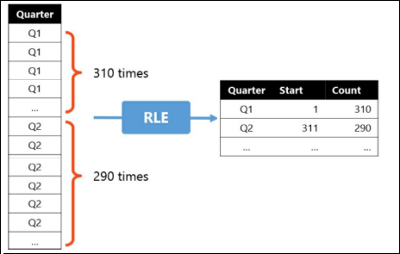
Compression Technique
RUN-LENGTH ENCODING
This technique aims to reduce the size of a dataset by avoiding repeated values.
Consider a column that contains the calendar quarter of a sale, which is stored in the Sales table. This column might have the string Q1 repeated many times in contiguous rows, for all the sales in the same quarter.
In such a case, VertiPaq avoids storing repeated values and replaces them with a slightly more complex structure. The structure contains the value only once, with the number of contiguous rows having the same value, as shown as below.
Notes:
Vertipaq – vertically packing data into columns

Slide 16
Compression Technique: Note
Please note that the actual details of the compression algorithm of VertiPaq are proprietary of Microsoft.
What we explain is a good approximation of what really happens in the engine and you can use it, to all effects, to understand how the VertiPaq engine stores data.
Notes:
Vertipaq – vertically packing data into columns

Slide 17
Improving Performance
The performance optimization process involves the following
Using correct data types.
Deleting unnecessary columns and rows.
Avoiding repeated values.
Replacing numeric columns with measures.
Reducing cardinalities
Analyzing model metadata.
Summarizing data where possible.
Notes:
Vertipaq – vertically packing data into columns

Slide 18
Demo: Improving Performance
In this demo, we will see
1 Improving Performance
1.1 Viewing the DAX Model Info in DAX Studio
1.2 Remove tables from Model that are not used
1.3 Remove columns from tables that are not used
1.4 Disable auto-generation of date tables
1.4.1 Power BI
1.4.2 Viewing Model Info in DAX Studio

Slide 19
Enriching Solution
Adding Calculated Columns
Adding Measures
Add new columns, which compute the values row by row
Summarize the data into a single value

Slide 20
What are Calculated Columns
A calculated column is computed at the row level of the table to which it belongs.
An Expression producing a column
Computed at time of refresh
Stored within the table
Limited By Row Context
Sales = UnitPrice * Qty
When you use Sales=UnitPrice * Qty in a calculated column, you mean the value of the UnitPrice and Qty column in the current row.

Slide 21
What are Measures
A measure is evaluated in the context of the cell of the pivot table or DAX query
An Expression summarizing the data
Computed at runtime
Stored temporarily
Limited By Filter Context (As applied)
Total GrossSales = Sum ( Sales[Sales] )
Order ID | Order Date | Customer ID | Sales Amount | Payment Status
1001 | 1-Jan-18 | 4 | 340 | Complete
1002 | 2-Jan-18 | 4 | 307 | Pending
1003 | 3-Jan-18 | 2 | 101 | Complete
1004 | 4-Jan-18 | 3 | 335 | Pending
1005 | 5-Jan-18 | 4 | 206 | Complete
1006 | 6-Jan-18 | 3 | 145 | Complete
1007 | 7-Jan-18 | 2 | 166 | Pending
Payment Status | Sales Amount
Complete | 792
Pending | 808
Grand Total | 1600
Summarize
When you use SUM(Sales[SalesAmount]) in a measure, you mean the sum of all the cells that are aggregated under this cell

Slide 22
Demo: Calculations in DAX
1. Calculations in DAX
1.1 Calculated Column
1.1.1 Create Name Column
1.2 Measure
1.2.1 Calculating the Sales
1.3 Calculate Function
1.3.1 Using Calculate function to display the %age of Sales by each state

Slide 23
Calculated Columns vs. Measures
Question: when you should use a Column VS Measure?
Answer:
Calculated columns (and tables) are:
Evaluated for each row in your table, immediately after you hit 'Enter' to complete the formula
Saved back into the model so take up space
Ideal for operational , detailed information
Measures are:
Evaluated when you use it in a visual, when the visual is rendered
Not saved anywhere (well, actually there's a cache in the report layer but it's not part of the file when you hit Save)
Ideal for analytical /summary information.

Slide 24
Calculated Columns vs. Measures
As a rule of thumb:
If you intend to apply any aggregation to a value (ie. sum, average etc) that shows a result, then stick to a Measure.
Calculated columns are often used when you want to filter on the result. So, If you intend to use the value for formatting purposes (ie. slicers, row/column category) then add a Column.

Slide 25
Demo: Common Requirements (via DAX)
Common Requirements in Reports (via DAX)
Displaying Rank of Total Sales /No of Incidences (using Variables)
Rank for Category Wise Sales
Rank for State Wise Sales (With State in Customer Table)
Rank for City Wise Incidents (With State in Customer Table), where-in some cities may not have reported incidents
Use Parameter Table to display the (sale /any other field) values in Hundreds, Thousands, Millions or Billions
Making use of relationship different from active relation
Displaying %age based on only the selected categories in slicers

Slide 26

Knowledge Check
Which are calculated on demand? Calculated columns or Measures?
Measures
Calculated column
Depends on the context
Depends on Query Type
Which are based on filters? Calculated columns or Measures based?
Measures
Calculated column
Depends on the context
Depends on Query Type
Which DAX function evaluates an expression in a modified filter context?
Calculate
CalculateMeasure
CalculateValue

Slide 27
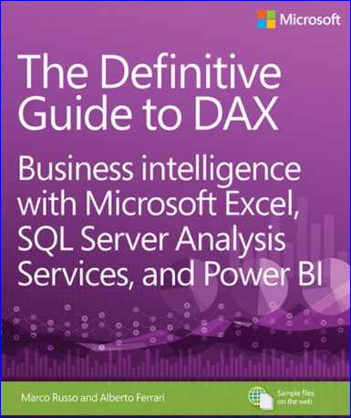
Reference: DAX Book
Definitive Guide To DAX

Slide 28
THANK YOU!

